Slide 1

Systems Engineering and Engineering Management Department
EMGT 6952 Engineering Optimization
Project Members:
Dishant Banga
Rojan Bhattarai
Joseph Carson
Date: December 11, 2017

Slide 2
Distribution Problem Using Optimization Programing Analysis Overview
Description of the Problem to Solved
Data Analysis of Distribution Network
Modeling Strategy to each Distribution Problem
Solution Approach
Conclusion /Overall Observation of Distribution problem

Slide 3
Distribution Problem Statement 1
A company has two factories, one at Atlanta(GA) and one at Charlotte (NC). In addition,it has four warehouses with storage facilities at Birmingham (AL), Greenville(SC), Gastonia (NC), and Augusta(GA). The company sells its product to six customers C1, C2, C3,C4,C5 , C6. Customers can be supplied from either a warehouse or the factory directly. Distribution costs are given in the following table (in $ per ton delivered)

Slide 4
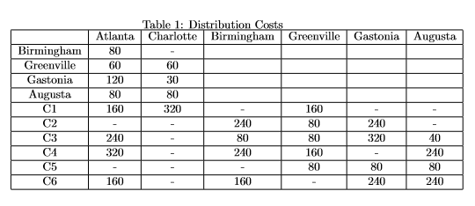
Data Analysis :Distribution Cost per Possible Route
Constraints : Monthly Capacity (tons) |Customer Monthly Requirements
Atlanta 150,000 C1: 50,000
Charlotte 200,00 C2: 10,000
Birm 70,000 C3: 40,000
Greenville 50,000 C4: 35,000
Gastonia 100,000 C5: 60,000
Augusta 40,000 C6: 20,000
.
Customer Preferences :
C1: Atlanta
C2: Birmingham
C3: No Preference
C4: No Preference
C5: Greenville
C6: Gastonia or Augusta

Slide 5
Distribution Problem Statement 1 Objectives
Determine the distribution pattern that would minimize overall cost
Determine the eﬀect of increasing factory and warehouse capacities that would be on distribution costs
What the eﬀects of small changes in costs, capacities and requirements would be on the distribution pattern?
Would it be possible to meet all customer preferences regarding suppliers, and if so what would the extra cost of doing this be?

Slide 6
Distribution Network Modeling
Determine the Decision Variables of the Model
Develop the Objective Function and Subject to Constraints
Using the Excel and MATLAB Programming Software to find the best Optimal Solution.

Slide 7
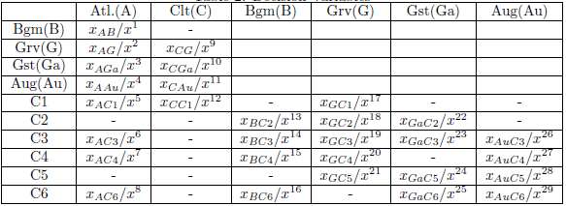
Modeling Strategy Problem 1
WHEN CUSTOMER PREFERENCE IS NOT CONSIDERED
Decision Variables

Slide 8
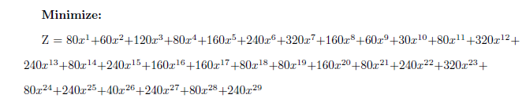
Modeling Strategy Problem 1
WHEN CUSTOMER PREFERENCE IS NOT CONSIDERED
Objective function

Slide 9
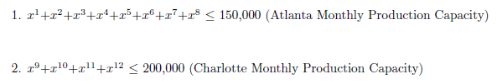
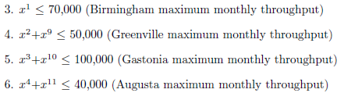
Modeling Strategy Problem 1
WHEN CUSTOMER PREFERENCE IS NOT CONSIDERED
Inequality Constraints
Factory Production Constraints:
Warehouse throughput constraints:

Slide 10
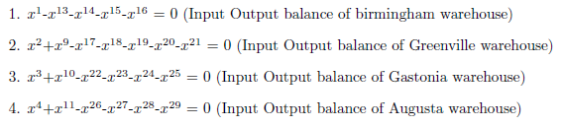
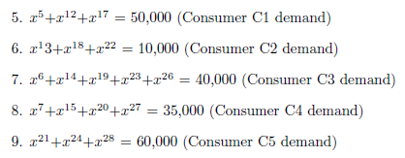

Modeling Strategy Problem 1
WHEN CUSTOMER PREFERENCE IS NOT CONSIDERED
equality Constraints
Warehouse input output balance
Consumer Demand

Slide 11

Modeling Strategy Problem 1
WHEN CUSTOMER PREFERENCE IS NOT CONSIDERED
Non-negativity constraints

Slide 12
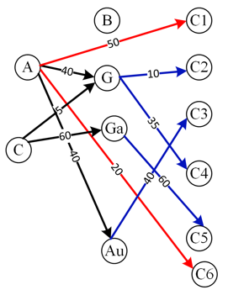
Solution
Distribution Pattern (when consumer preference not considered)And, the minimum cost is $31,700,000.

Slide 13
Modeling Strategy Problem 1
It was observed that not all the customer preference regarding suppliers was met (in the initial solution),the extra cost incurred to meet the preference requirement is $ 9,000,000.
it is impossible to met the demand of customer C5 from its preferred location of Greenville as C5 demands 60,000 items but Greenville only has a throughput capacity of 50,000.

Slide 14
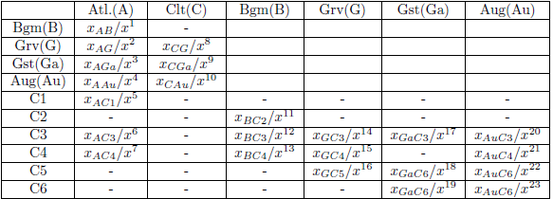
Modeling Strategy Problem 1
WHEN CUSTOMER PREFERENCE IS CONSIDERED
Decision Variables

Slide 15
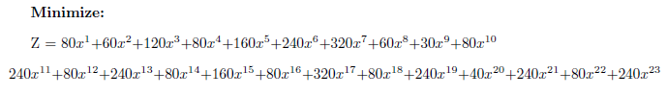
Modeling Strategy Problem 1
WHEN CUSTOMER PREFERENCE IS CONSIDERED
Objective function

Slide 16

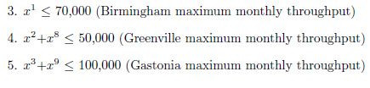
Modeling Strategy Problem 1
WHEN CUSTOMER PREFERENCE IS CONSIDERED
Inequality Constraints
Factory Production Constraints:
Warehouse throughput constraints:

Slide 17
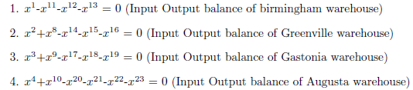
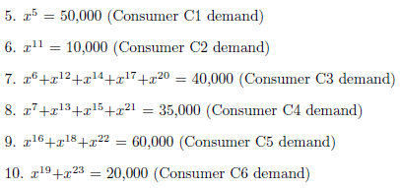
Modeling Strategy Problem 1
WHEN CUSTOMER PREFERENCE IS CONSIDERED
Equality Constraints
Warehouse input output balance
Consumer Demand

Slide 18

Modeling Strategy Problem 1
WHEN CUSTOMER PREFERENCE IS NOT CONSIDERED
Non-negativity constraints

Slide 19
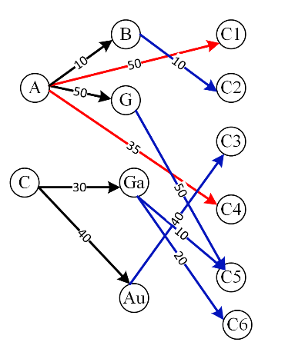
Solution
Distribution Pattern (when consumer preference considered)And, the minimum cost is $40,700,000.

Slide 20
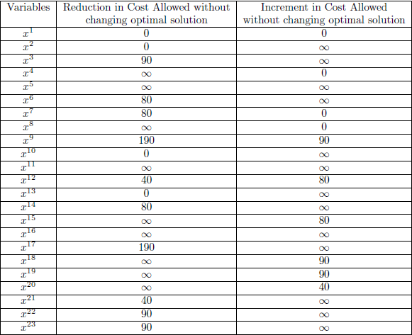
SENSETIVITY ANALYSIS
Cost Sensitivity Analysis

Slide 21
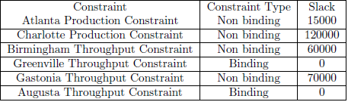
SENSETIVITY ANALYSIS
Factories/Warehouse Constraint analysis

Slide 22
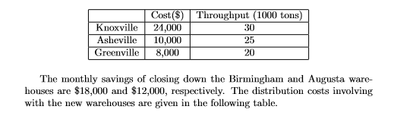
Distribution Problem Statement 2
There is a possibility of opening new warehouses at Knoxville (TN) and Asheville (NC), as well as of enlarging the Greenville warehouse. It is not considered desirable to have more than four warehouses and if necessary Birmingham or Augusta(or both) can be closed down. The monthly costs (in interest charges) of the possible new warehouses and expansion at Greenville are given in the following table together with the potential monthly throughputs.

Slide 23
Distribution Problem Statement 2 Objective
Which new warehouses should be built? Should Greenville be expanded? Should Birmingham or Augusta be closed down? What would be the best resultant distribution pattern to minimize overall costs?

Slide 24
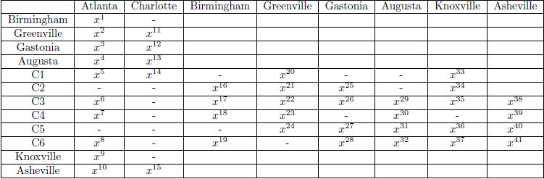
Modeling Strategy Problem 2
CUSTOMER PREFERENCE IS CONSIDERED
Decision Variables

Slide 25
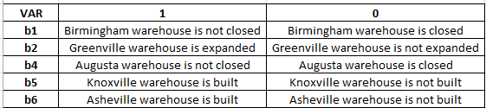
Modeling Strategy Problem 2
BINARY Decision Variables

Slide 26
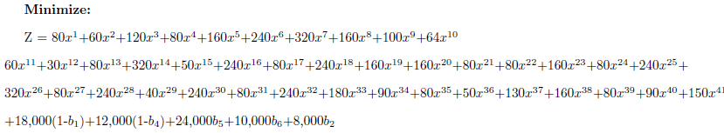
Modeling Strategy Problem 2
CUSTOMER PREFERENCE IS NOT CONSIDERED
Objective function

Slide 27

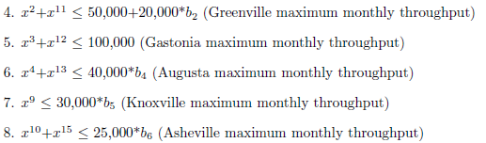
Modeling Strategy Problem 2
CUSTOMER PREFERENCE IS NOT CONSIDERED
Inequality Constraints
Factory Production Constraints:
Warehouse throughput constraints:

Slide 28
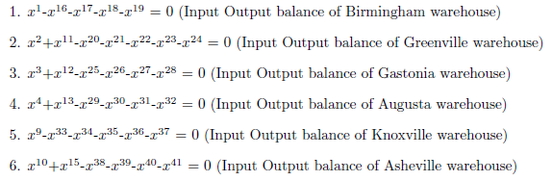
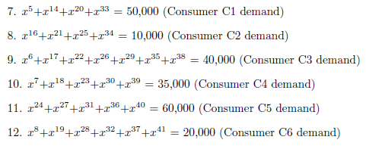
Modeling Strategy Problem 2
CUSTOMER PREFERENCE IS NOT CONSIDERED
equality Constraints
Warehouse input output balance
Consumer Demand

Slide 29


Modeling Strategy Problem 2
CUSTOMER PREFERENCE IS NOT CONSIDERED
Non-negativity constraints
Binary constraints

Slide 30
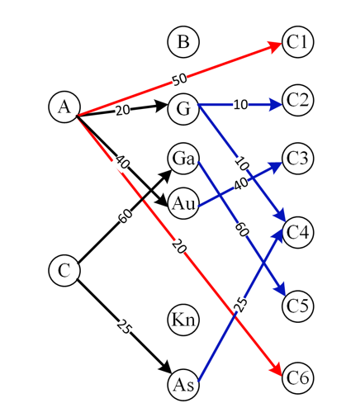
Solution
New warehouse should be built in Asheville
Greenville warehouse need not be expanded
Birmingham warehouse needs to be closed down

Slide 31
Conclusion / Overall Observation
An optimal distribution pattern was found for product distribution of a company.
It was observed that multiple optimal solution path can exist.
The analysis related to whether new warehouses should be built or not based on the corresponding prices were also analyzed

Slide 32

THANK YOU !!!

